Slide 1
MATHEMATICAL FOUNDATION FOR COMPUTER SCIENCE
Prepared by: Er. Ankit Kharel
Nepal college of information technology

Slide 2
Graph Theory

Slide 3
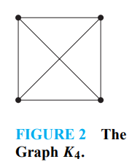
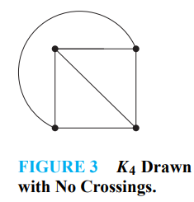
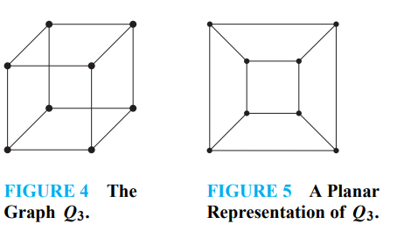
Planar GRAPHs:
A graph is called planar if it can be drawn in the plane without any edges crossing (where a crossing of edges is the intersection of the lines or arcs representing them at a point other than their common endpoint). Such a drawing is called a planar representation of the graph.
A graph may be planar even if it is usually drawn with crossings, because it may be possible to draw it in a different way without crossings.
A planar representation of a graph splits the plane into regions, including an unbounded region.
5. A complete graph of five vertices is non planar.
R3
R1
R1
R2
R4
R3
R6
R2
R4
R5

Slide 4
Planar GRAPHs:
EULER’S FORMULA : Let G be a connected planar simple graph with e edges and v vertices. Let r be the number of regions in a planar representation of G. Then r = e − v + 2.
Poof:
We will use Mathematical induction
Base Case:
For n=1 i.e. For number of edge = 1.
r₁ = e₁ – v₁ + 2
r₁ = 1-2+2
r₁ = 1 (TRUE)
(b) Induction Hypothesis:
Assume the equation is true for n=k i.e. for number of edges = k
r_{k} = e_{k} – v_{k} + 2 is true for G_{k}
(c) Induction Step:
Let {a_{k+1}, b_{k+1}} be the edge that is added to G_{k} to obtain G_{k+1}.
R1

Slide 5
Planar GRAPHs:
(c) Induction Step:
Let {a_{k+1}, b_{k+1}} be the edge that is added to G_{k} to obtain G_{k+1}.
There are two case to be considered:
i. Both a_{k+1} and b_{k+1} are already in G_{k}
r_{k+1} = r_{k}+1
e_{k+1} = e_{k} + 1
v_{k+1} = v_{k} {Because both vertices are in G_{k}}
r_{k+1} = e_{k+1} - v_{k+1} + 2
r_{k}+1 = e_{k} + 1 - v_{k} + 2
r_{k} = e_{k} – v_{k} + 2 which is true
ii. One vertices is added to G_{k}
r_{k+1} = r_{k}
e_{k+1} = e_{k} + 1
v_{k+1} = v_{k} +1 {Because one vertices is added in G_{k}}
r_{k+1} = e_{k+1} - v_{k+1} + 2
r_{k} = e_{k} + 1 – (v_{k} + 1) + 2
r_{k} = e_{k} – v_{k} + 2 which is true
Hence by induction method Euler’s Formula is proved
a_{k+1}
b_{k+1}
b_{k+1}
a_{k+1}

Slide 6
Planar GRAPHs:
4 Suppose that a connected planar simple graph has 20 vertices, each of degree 3. Into how many regions does a representation of this planar graph split the plane?
Solution:
This graph has 20 vertices, each of degree 3, so v = 20
Now using Handshaking theorem ,
2e = (20*3)
e = 30
Consequently, from Euler’s formula, the number of regions is
r = e − v + 2
r = 30 − 20 + 2
r = 12.

Slide 7
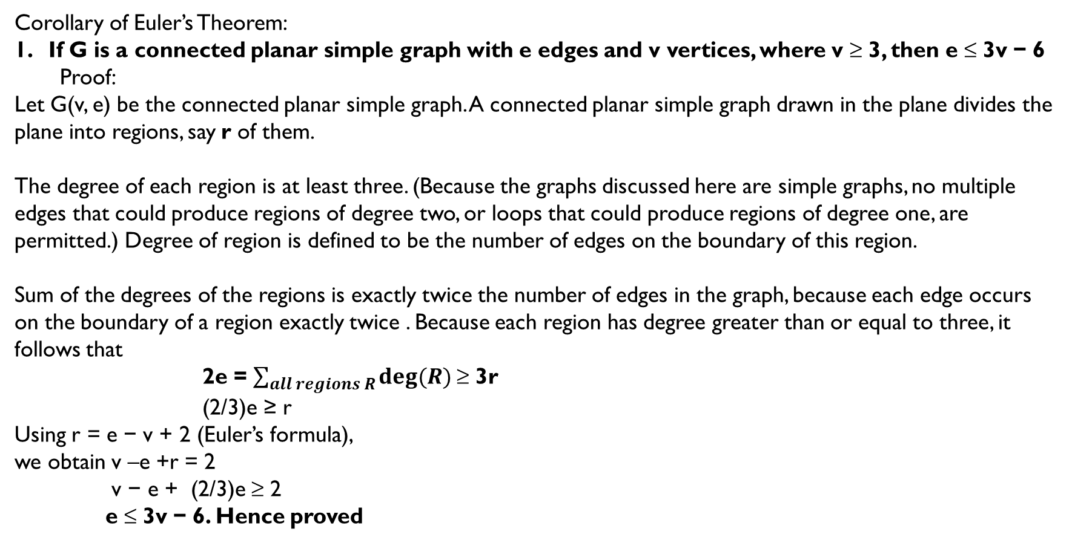
Planar GRAPHs:
Corollary of Euler’s Theorem:
If G is a connected planar simple graph with e edges and v vertices, where v ≥ 3, then e ≤ 3v − 6
Proof:
Let G(v, e) be the connected planar simple graph. A connected planar simple graph drawn in the plane divides the plane into regions, say r of them.
The degree of each region is at least three. (Because the graphs discussed here are simple graphs, no multiple edges that could produce regions of degree two, or loops that could produce regions of degree one, are permitted.) Degree of region is defined to be the number of edges on the boundary of this region.
Sum of the degrees of the regions is exactly twice the number of edges in the graph, because each edge occurs on the boundary of a region exactly twice . Because each region has degree greater than or equal to three, it follows that
2e = $\sum_{all regions R}{deg⁡(R)}$≥ 3r
(2/3)e ≥ r
Using r = e − v + 2 (Euler’s formula),
we obtain v –e +r = 2
v − e + (2/3)e ≥ 2
e ≤ 3v − 6. Hence proved

Slide 8
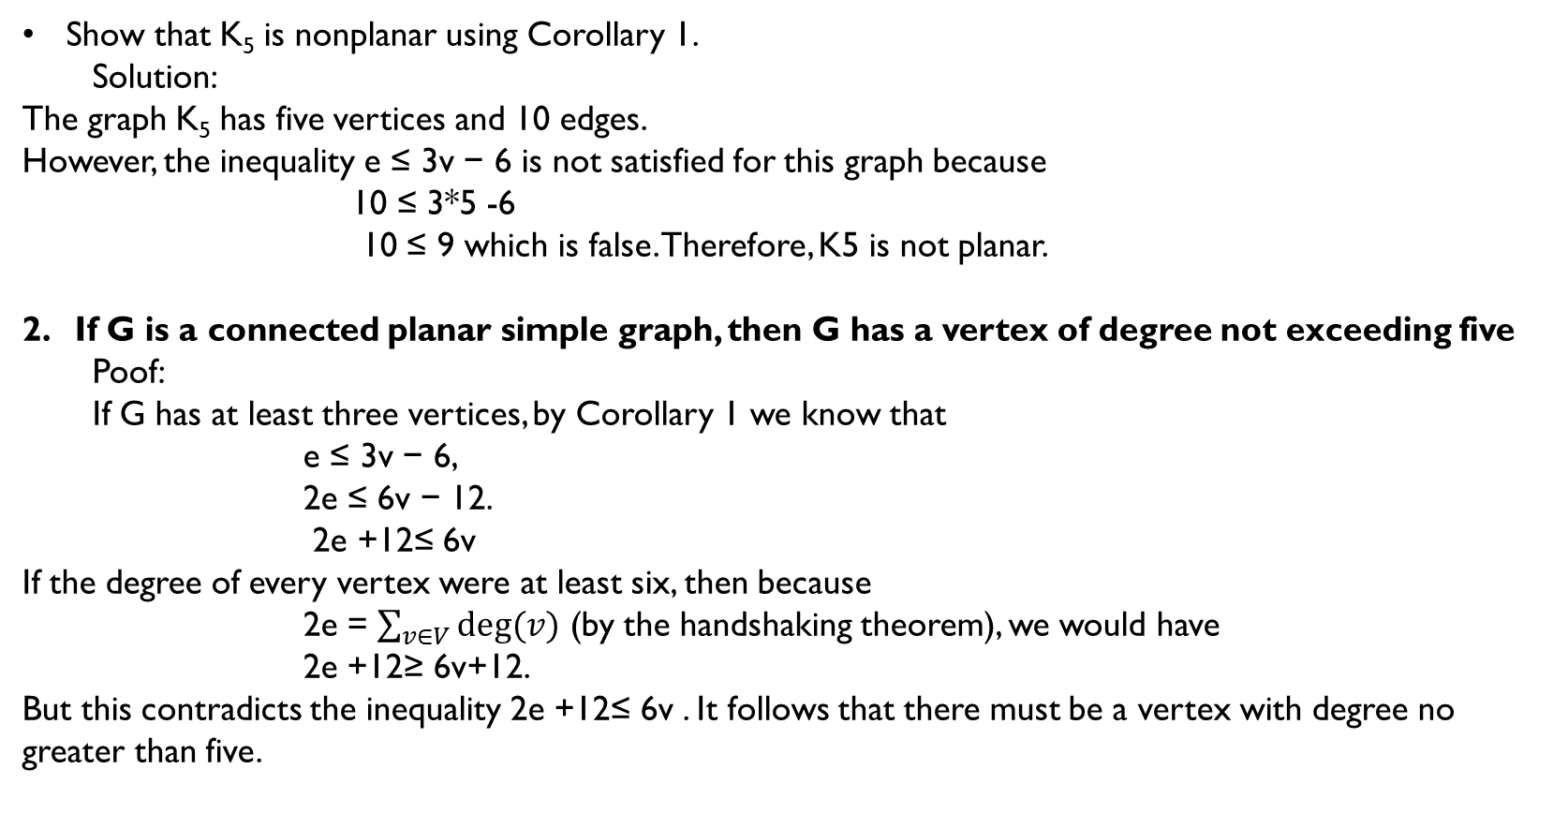
Planar GRAPHs:
Show that K₅ is nonplanar using Corollary 1.
Solution:
The graph K₅ has five vertices and 10 edges.
However, the inequality e ≤ 3v − 6 is not satisfied for this graph because
10 ≤ 3*5 -6
10 ≤ 9 which is false. Therefore, K5 is not planar.
If G is a connected planar simple graph, then G has a vertex of degree not exceeding five
Poof:
If G has at least three vertices, by Corollary 1 we know that
e ≤ 3v − 6,
2e ≤ 6v − 12.
2e +12≤ 6v
If the degree of every vertex were at least six, then because
2e = $\sum_{v∈V}{deg⁡(v)}$ (by the handshaking theorem), we would have
2e +12≥ 6v+12.
But this contradicts the inequality 2e +12≤ 6v . It follows that there must be a vertex with degree no greater than five.

Slide 9
Planar GRAPHs:

